Slide 1

8/2/24
DA-IICT
Requirements Elicitation Techniques
Saurabh Tiwari
Overview
Elicitation Techniques Analysis of Existing Systems – Documentation, Observation, and Ethnography Interviews Brainstorming Joint Application Design (JAD) Prototyping Use Cases When people talk, listen completely. Most people never listen.¹ [1] Ernest Miller Hemingway (1899-1961)

Slide 2
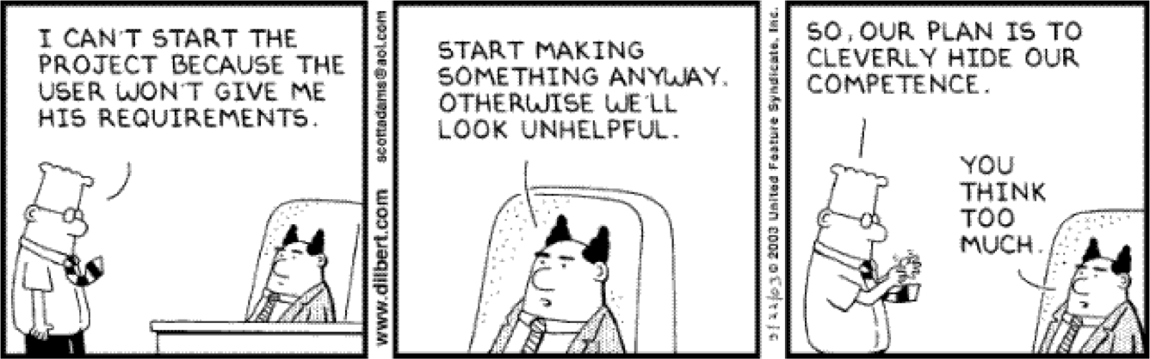
8/2/24
Elicitation Techniques
Elicitation techniques Stakeholder analysis Analysis of existing systems or documentation, background reading Discourse analysis Task observation, ethnography Questionnaires Interviewing Brainstorming Joint Application Design (JAD) Prototyping Pilot system Use cases and scenarios Risk analysis

Slide 3
8/2/24
Comparison of Data-Gathering Techniques¹
Technique | Good for | Kind of data | Plus | Minus
Questionnaires | Answering specific questions | Quantitative and qualitative data | Can reach many people with low resource | The design is crucial. Response rate may be low. Responses may not be what you want
Interviews | Exploring issues | Some quantitative but | Interviewer can guide | Time consuming.
 |  | mostly qualitative data | interviewee. | Artificial environment
 |  |  | Encourages contact | may intimidate
 |  |  | between developers | interviewee
 |  |  | and users
Focus groups and | Collecting multiple | Some quantitative but | Highlights areas of | Possibility of dominant
workshops | viewpoints | mostly qualitative data | consensus and | characters
 |  |  | conflict. Encourages
 |  |  | contact between
 |  |  | developers and users
Naturalistic observation | Understanding context of user activity | Qualitative | Observing actual work gives insight that other techniques cannot give | Very time consuming. Huge amounts of data
Studying | Learning about | Quantitative | No time commitment | Day-to-day work will
documentation | procedures, |  | from users required | differ from documented
 | regulations, and |  |  | procedures
 | standards
[1] Preece, Rogers, and Sharp “Interaction Design: Beyond human-computer interaction”, p214
Analysis of Existing Systems

Slide 4
8/2/24
Analysis of Existing Systems (1)
Useful when building a new improved version of an existing system Important to know: What is used, not used, or missing What works well, what does not work How the system is used (with frequency and importance) and it was supposed to be used, and how we would like to use it
Analysis of Existing Systems (2)
Why analyze an existing system? Users may become disillusioned with new system or do not like the new system if it is too different or does not do what they want (risk of nostalgia for old system) To appropriately take into account real usage patterns, human issues, common activities, relative importance of tasks/features To catch obvious possible improvements (features that are missing or do not currently work well) To find out which "legacy" features can/cannot be left out

Slide 5
8/2/24
Review Available Documentation
Start with reading available documentation User documents (manual, guides…) Development documents Requirements documents Internal memos Change histories – … Of course, often these are out of date, poorly written, wrong, etc., but it's a good starting point Discourse analysis Use of words and phrases is examined in written or spoken language
Observation and Related Techniques | (1)
Observation Get into the trenches and observe specialists “in the wild” Shadow important potential users as they do their work Initially observe silently (otherwise you may get biased information) Ask user to explain everything he or she is doing Session videotaping Ethnography also attempts to discover social, human, and political factors, which may also impact requirements

Slide 6
8/2/24
Observation and Related Techniques (2)
Can be supplemented later with questionnaires
Based on what you know now – the results of observation
To answer questions that need comparison or corroboration (confirmation)
To obtain some statistics from a large number of users (look for statistical significance!), e.g.:
How often do you use feature X?
What are the three features you would most like to see?
Can be supplemented later with interviews
After getting a better idea of what is to be done, probably some questions require more detailed answers
You will not be wasting other people's time or your own
This is very labour intensive!
Ethnography – Overview (1)
Comes from anthropology, literally means "writing the culture" Essentially seeks to explore the human factors and social organization of activities → understand work Studies have shown that work is often richer and more complex than is suggested by simple models derived from interviews Social scientists are trained in observation and work analysis Discoveries are made by observation and analysis, workers are not asked to explain what they do Collect what is ordinary/what is it that people do (aim at making the implicit explicit) Study the context of work and watch work being done

Slide 7
8/2/24
Ethnography – Overview (2)
Useful to discover for example What does a nuclear technician do during the day? What does his workspace look like? Less useful to explore political factors Workers are aware of the presence of an outside observer
Ethnography – Example (1)
Sommerville et al. were involved in a project where they had to elicit the requirements of an air traffic control system They observed the air traffic controllers in action with the existing system Surprising observations Controllers often put aircrafts on potentially conflicting headings with the intention of fixing them later System generates an audible alarm when there is a possible conflict The controllers close the alarms because they are annoyed by the constant warnings Incorrect conclusion The controllers do not like audible alarms because they close them More accurate observation The controllers do not like being treated like idiots

Slide 8
8/2/24
Ethnography – Example (2)
Dealers at a stock exchange write tickets to record deals with old-fashioned paper/pencil method It was suggested to replace this with touch screens and headphones for efficiency and to eliminate distracting noise Study found that the observation of other dealers is crucial to the way deals are done Market position was affected if deals were not continuously monitored Even if only peripheral monitoring takes place “Improvements" would have destroyed the very means of communication among dealers Source: Preece, Rogers, and Sharp “Interaction Design: Beyond human-computer interaction”
Interviews

Slide 9
8/2/24
Interviews (1)
Requires preparation and good communication management Achieve interview objectives without preventing the exploration of promising leads Interview as many stakeholders as possible Not just clients and users Ask problem-oriented questions Ask about specific details, but… Detailed and solution-specific questions may miss the stakeholder’s real requirements. Example: Would you like Word 2007, Excel 2007 or both? vs. Would you like to do word processing, computations, or both?
Interviews – Objectives and Process (2)
Three main objectives:
Record information to be used as input to requirements analysis and modeling
Discover information from interviewee accurately and efficiently
Reassure interviewee that his/her understanding of the topic has been explored, listened to, and valued
Process consists of four important steps:
Planning and preparation
Interview session
Consolidation of information
Follow-up
Many strategies for questioning

Slide 10
8/2/24
Interviews – Planning and Preparation
Important to plan and prepare interviews
Set goals and objectives for the interview
Acquire background knowledge of the subject matter to conduct an effective interview
About the domain (vocabulary, problems...) but also about the interviewee (work tasks, attitude...)
Prepare questions in advance, by subject
Organize the environment for conducting an effective interview
Determine how the elicitation notes will be taken (manually, audio, video, by whom…)
Interviews – Session
Make the interviewee comfortable and confident Be polite and respectful! Adjust to the interviewee – You have your goals – be persistent but flexible Interview several people at once to create synergy Try to detect political aspects as they may influence the said and the unsaid

Slide 11
8/2/24
Interviews – Elicitation Notes
Revise and complete the elicitation notes after the interview Needs to be done soon after because one forgets the details (and everything else) Identify inconsistencies and address them in a follow-up interview or by email Keep all diagrams, charts, models created during the discussions You are learning, so be precise Pay attention to terminology Use the interviewee’s terminology Identify synonyms Create a glossary if necessary
Common Interviewing Mistakes (1)
Not interviewing all of the right people
Different points of view of stakeholders
Asking direct questions too early
e.g., design of a transportation system:
How much horsepower do you need? (direct)
How many passengers? How far? How fast? (indirect)
e.g., camera design for novice photographer:
How important is control over shutter speed and aperture? (direct)
Will you be taking action shots, still shots, or both? (indirect)

Slide 12


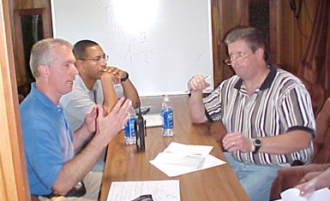











8/2/24
Common Interviewing Mistakes (2)
Interviewing one-at-a-time instead of in small groups
More people might help get juices flowing as in brainstorming
Users cannot think of everything they need when asked individually, but will recall more requirements when they hear others' needs
Reduces spotlight on individuals (may produce more interesting answers)
This interaction is called synergy, the effect by which group responses outperform the sum of the individuals' responses
Do not let one participant dominate the discussion
Assuming that stated needs are exactly correct
Often users do not know exactly what they want and order "what he is eating"
Need to narrow what is asked for down to what is needed
Common Interviewing Mistakes (3)
Trying to convince stakeholders that YOU are smart – wrong place to do that!
Instead take every opportunity to show you think the stakeholder
^{is smart} My Elevators
Contrast these two cases¹ _{Are}
Too Slow!
I See.
Tell Me Why You Feel They Are Too Slow.
I Don’t Think So.
I Think You Have an Elevator Throughput Problem, not a Speed Problem
[1] Alan M. Davis “Just enough requirements management”

Slide 13
8/2/24
Interviews – Start Up Questions (1)
Context-free questions to narrow the scope a bit (Weinberg)
Identify customers, goals, and benefits
Who is (really) behind the request for the system?
Who will use the system? Willingly?
Are there several types of users?
What is the potential economic benefit from a successful solution?
Is a (pre-existing) solution available from another source?
Elicitation Techniques Existing Systems Interviews Brainstorming Joint Application Design Prototyping Use Cases Interviews – Start Up Questions (2)
When do you need it by? Can you prioritize your needs? What are your constraints? Time Budget Resources (human or otherwise) Expected milestones (deliverables and dates)?

Slide 14
8/2/24
Elicitation Techniques Existing Systems Interviews Brainstorming Joint Application Design Prototyping Use Cases Interviews – Start Up Questions (3)
Try to characterize the problem and its solution What would be a "good" solution to the problem? What problems is the system trying to address? In what environment will the system be used? Any special performance issues? Other special constraints? What is (un)likely to change? Future evolution? What needs to be flexible (vs. quick & dirty)?
Interviews – Start Up Questions (4)
Calibration and tracking questions
Are you the right person to answer these questions?
Are your answers "official"? If not, whose are?
Are these questions relevant to the problem as you see it?
Are there too many questions? Is this the correct level of detail?
Is there anyone else I should talk to?
Is there anything else I should be asking you? Have you told me everything you know about the problem?
Do you have any questions?

Slide 15
8/2/24
Interviews – Start Up Questions (5)
Questions that cannot be asked directly (ask indirectly) Are you opposed to the system? Are you trying to obstruct/delay the system? Are you trying to create a more important role for yourself? Do you feel threatened by the proposed system? Are you trying to protect your job? Is your job threatened by the new system? Is anyone else's?
Interviews – Specific Questions (1)
Functional requirements
What will the system do?
When will the system do it?
Are there several modes of operations?
What kinds of computations or data transformations must be performed?
What are the appropriate reactions to possible stimuli?
For both input and output, what should be the format of the data?
Must any data be retained for any period of time?

Slide 16
8/2/24
Interviews – Specific Questions (2)
Design Constraints
Physical environment
Where is the equipment to be located?
Is there one location or several?
Are there any environmental restrictions, such as temperature, humidity, or magnetic interference?
Are there any constraints on the size of the system?
Are there any constraints on power, heating, or air conditioning?
Are there constraints on the programming language because of existing software components?
Interviews – Specific Questions (3)
Design Constraints Interfaces Is input coming from one or more other systems? Is output going to one or more other systems? Is there a prescribed way in which input/output need to be formatted? Is there a prescribed way for storing data? Is there a prescribed medium that the data must use? Standards Are there any standards relevant to the system?

Slide 17
8/2/24
Interviews – Specific Questions (4)
Performance
Are there constraints on execution speed, response time, or throughput?
What efficiency measure will apply to resource usage and response time?
How much data will flow through the system?
How often will data be received or sent?
Interviews – Specific Questions (5)
Usability and Human Factors
What kind of training will be required for each type of user?
How easy should it be for a user to understand and use the system?
How difficult should it be for a user to misuse the system?

Slide 18
8/2/24
Interviews – Specific Questions (6)
Security
Must access to the system or information be controlled?
Should each user's data be isolated from data of other users?
Should user programs be isolated from other programs and from the operating system?
Should precautions be taken against theft or vandalism?
Interviews – Specific Questions (7)
Reliability and Availability
Must the system detect and isolate faults?
What is the prescribed mean time between failures?
Is there a maximum time allowed for restarting the system after failure?
How often will the system be backed up?
Must backup copies be stored at a different location?
Should precautions be taken against fire or water damage?

Slide 19
8/2/24
Interviews – Specific Questions (8)
Maintainability
Will maintenance merely correct errors, or will it also include improving the system?
When and in what ways might the system be changed in the future?
How easy should it be to add features to the system?
How easy should it be to port the system from one platform (computer, operating system) to another?
Interviews – Specific Questions (9)
Precision and Accuracy
How accurate must data calculations be?
To what degree of precision must calculations be made?

Slide 20
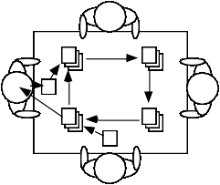
8/2/24
Brainstorming
Brainstorming
To invent new way of doing things or when much is unknown When there are few or too many ideas Early on in a project particularly when: Terrain is uncertain There is little expertise for the type of applications Innovation is important (e.g., novel system) Two main activities: The Storm: Generating as many ideas as possible (quantity, not quality) – wild is good! – The Calm: Filtering out of ideas (combine, clarify, prioritize, improve…) to keep the best one(s) – ! ! may require some voting strategy ! Roles: scribe, moderator (may also provoke), ! ! participants !

Slide 21
8/2/24
Brainstorming – Objectives
Hear ideas from everyone, especially unconventional ideas Keep the tone informal and non-judgemental Keep the number of participants “reasonable“ – if too many, consider a “playoff “-type filtering and invite back the most creative to multiple sessions Encourage creativity Choose good, provocative project name. Choose good, provocative problem statement Get a room without distractions, but with good acoustics, whiteboards, coloured pens, provide coffee/donuts/pizza/beer Provide appropriate props/mock-ups
Brainstorming – Roles
Scribe Write down all ideas (may also contribute) May ask clarifying questions during first phase but without criticizing Moderator/Leader Cannot be the scribe Two schools of thought: traffic cop or agent provocateur Traffic cop – enforces "rules of order", but does not throw his/her weight around otherwise Agent provocateur – traffic cop plus more of a leadership role, comes prepared with wild ideas and throws them out as discussion wanes May also explicitly look for variations and combinations of other suggestions

Slide 22
8/2/24
Brainstorming – Participants
Virtually any stakeholder, e.g. Developers Domain experts End-users Clients – ... “Ideas-people” – a company may have a special team of people Chair or participate in brainstorming sessions Not necessarily further involved with the project
Brainstorming – The Storm
Goal is to generate as many ideas as possible Quantity, not quality, is the goal at this stage Look to combine or vary ideas already suggested No criticism or debate is permitted – do not want to inhibit participants Participants understand nothing they say will be held against them later on Scribe writes down all ideas where everyone can see e.g., whiteboard, paper taped to wall Ideas do not leave the room Wild is good Feel free to be gloriously wrong Participants should NOT censor themselves or take too long to consider whether an idea is practical or not – let yourself go!

Slide 23
8/2/24
Brainstorming – The Calm
Go over the list of ideas and explain them more clearly Categorize into "maybe" and "no" by pre-agreed consensus method Informal consensus 50% + 1 vote vs. “clear majority” Does anyone have veto power? Be careful about time and people Meetings (especially if creative or technical in nature) tend to lose focus after 90 to 120 minutes – take breaks or reconvene later Be careful not to offend participants Review, consolidate, combine, clarify, improve Rank the list by priority somehow Choose the winning idea(s)
Brainstorming – Eliminating Ideas
There are some common ways to eliminate some ideas Blending ideas Unify similar ideas but be aware not to force fit everything into one idea Give each participant $100 to spend on the ideas Apply acceptance criteria prepared prior to meeting Eliminate the ideas that do not meet the criteria Various ranking or scoring methods Assign points for criteria met, possibly use a weighted formula Vote with threshold or campaign speeches Possibly select top k for voting treatment

Slide 24
8/2/24
Brainstorming – Voting on Ideas
Voting with threshold Each person is allowed to vote up to n times Keep those ideas with more than m votes Have multiple rounds with smaller n and m Voting with campaign speeches Each person is allowed to vote up to j < n times Keep those ideas with at least one vote Have someone who did not vote for an idea defend it for the next round Have multiple rounds with smaller j
Brainstorming – Tool Support
With many good ideas, some outrageous and even farfetched, brainstorming can be really fun! Creates a great environment that stimulates people and motivates them to perform well! Can be done by email, but a good moderator/leader is needed to Prevent flamers to come into play Prevent race conditions due to the asynchronous communication medium Be careful not to go into too much detail Collaboration tools are also possible TWiki and many other more appropriate tools such as BrainStorm and IdeaFisher

Slide 25
8/2/24
Joint Application Design (JAD)
Joint Application Design (JAD)
A more structured and intensive brainstorming approach Developed at IBM in the 1970s Lots of success stories "Structured brainstorming", IBM-style Full of structure, defined roles, forms to be filled out... Several activities and six (human) roles to be played JAD session may last few days The whole is more than the sum of its parts. The part is more than a fraction of the whole.¹ [1] Aristotle (384 BC – 322 BC)

Slide 26
8/2/24
Joint Application Design – Four Main Tenets
Effective use of group dynamics Facilitated and directed group sessions to get common understanding and universal buy-in Use of visual aids To enhance understanding, e.g., props, prepared diagrams Defined process I.e., not a random hodgepodge Standardized forms for documenting results
Joint Application Design – Applicability
Used for making decisions on different aspects of a project
Any process where consensus-based decision making across functional areas is required, e.g.,
Planning a project
Defining requirements
Designing a solution

Slide 27
8/2/24
Joint Application Design – Activities
Preparation Pre-session Planning Pre-work Working Session Summary Follow-up Wrap-up
Joint Application Design – Pre-session
Planning
Preparation is essential – this is not an informal session
Evaluate project
– Identify contentious issues and scope of JAD session
Select JAD participants
Create preliminary agenda
Determine deliverables for the working session
Enable participants to prepare for the session

Slide 28
8/2/24
The 6 “P”s
Purpose - Why do we do things? (Goals, needs, motivation) Participants - Who is involved? (People, roles, responsibilities) Principles - How do we function? (Guidelines, working agreements, ground rules) Products - What do we create? (Deliverables, decisions, plans, next steps) Place - Where is it located? (Venue, logistics) Process - When do we do what? (Activities, sequence) [1] Ellen Gottesdiener, Requirements by Collaboration: Facilitating Workshops to Define Stakeholder Needs, RE Conference 2006
Joint Application Design – Pre-work
Gather information Clear schedules for the working session Refine session agenda Finalize pre-session assignments Prepare material for session (flip-charts, presentations, markers, pizza...)

Slide 29
8/2/24
Joint Application Design – Working Session
Set-up stage Session leader welcomes participants, presents task to be discussed, establishes rules and what is on/off topic… Generate common understanding Brainstorming… Achieve consensus on decisions Generate ownership of results Create the deliverables (using standard JAD forms) Identify open issues and questions
Joint Application Design – Follow-up and
Wrap-up
Follow-up
Resolve open issues and questions
Follow-up on action items
Re-evaluate project
Wrap-up
Review results of follow-up items
Evaluate the JAD process
Discuss "lessons learned"
Finalize deliverables

Slide 30
8/2/24
Joint Application Design – Roles (1)
Session leader
Organizer, facilitator, JAD expert
Good with people skills, enthusiastic, sets tone of meeting
Analyst
Scribe++
Produces official JAD documents, experienced developer who understands the big picture, good philosopher/writer/organizer
Executive sponsor
Manager who has ultimate responsibility for product being built
Provides strategic insights into company's high-level goals/practices, makes executive decisions later on as required
Joint Application Design – Roles (2)
User representatives
Selection of knowledgeable end-users and managers
Come well-prepared with suggestions and ideas of needs, will brainstorm for new or refined ideas, eventually review completed JAD documents
Information system representatives
Technical expert on ISs
Helps users think big, know what is easy/hard/cheap/expensive, mostly there to provide information rather than make decisions
Specialists
Technical expert on particular narrow topics, e.g., security, application domain, law, UI issues…

Slide 31
8/2/24
Prototyping
Prototyping
A software requirements prototype is a mock-up or partial implementation of a software system Helps developers, users, and customers better understand system requirements Helps clarify and complete requirements Provides early response to “I'll know it when I’ll see (or won’t see) it” attitude Effective in addressing the “Yes, But” and the “Undiscovered Ruins” syndromes Helps find new functionalities, discuss usability, and establish priorities Prototyping is effective in resolving uncertainties early in the development process Focus prototype development on these uncertain parts Encourages user participation and mutual understanding

Slide 32
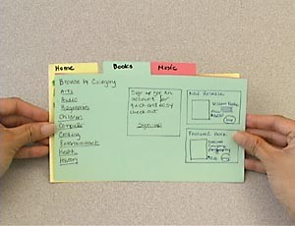
8/2/24
Prototyping – Realizations
Prototypes can take many forms:
Paper prototypes (see http://www.paperprototyping.com/)
Prototype on index card
Storyboard
Screen mock-ups
Interactive prototypes
Using high-level languages (e.g., Visual Basic, Delphi, Prolog)
Using scripting languages (e.g., Perl, Python)
Using animation tools (e.g., Flash/Shockwave)
Models (executables)
Pilot systems
– …
Prototyping – Types
Horizontal: focus on one layer – e.g., user interface Vertical: a slice of the real system Evolutive: turned into a product incrementally, gives users a working system more quickly (begins with requirements that are more understood) Throw-away: less precise, thrown away, focusing on the less well-understood aspects of the system to design, designed to elicit or validate requirements

Slide 33
8/2/24
Prototyping – Fidelity (1)
Fidelity is the extent to which the prototype is real and (especially) reactive Fidelity may vary for throw-away prototypes High-fidelity Applications that "work" – you press a button and something happens Often involves programming or executable modeling languages Advantages: provides an understanding of functionality, reduce design risk, more precise verdicts about requirements Disadvantages: takes time to build, more costly to build, sometimes difficult to change, false sense of security, often focuses on details rather than on the goals and important issues
Prototyping – Fidelity (2)
Low-fidelity It is not operated – it is static Advantages: easy and quick to build, cheaper to develop, excellent for interfaces, offers the opportunity to engage users before coding begins, encourage creativity Disadvantages: may not cover all aspects of interfaces, are not interactive, may seem non-professional in the eyes of some stakeholders (sigh!)

Slide 34
8/2/24
Prototyping – Risks
Prototypes that focus on user-interface tends to lose the focus of demonstrating/exploring functionality Prototypes can bring customers’ expectations about the degree of completion unrealistically up Do not end-up considering a throwaway prototype as part of the production system – Always clearly state the purpose of each prototype before building it
Use Cases

Slide 35
8/2/24
Developing Use Case Models of Systems
Description of a sequence of interactions between a system and external actors
Developed by Ivar Jacobson
Not exclusively for object-oriented analysis
Actors – any agent that interact with the system to achieve a useful goal (e.g., people, other software systems, hardware)
Use case describes a typical sequence of actions that an actor performs in order to complete a given task
The objective of use case analysis is to model the system
… from the point of view of how actors interact with this system
… when trying to achieve their objectives
A use case model consists of
A set of use cases
An optional description or diagram indicating how they are related
Use Cases
A use case should describe the user’s interaction with the system ... Not the computations the system performs In general, a use case should cover the full sequence of steps from the beginning of a task until the en A use case should only include actions in which the actor interacts with the computer Some views differ on this one!!!

Slide 36
8/2/24
Use Cases – Abstraction Level
A use case should be written so as to be as independent as possible from any particular implementation / user interface design Essential use cases (Constantine & Lockwood) Abstract, technology free, implementation independent Defined at earlier stages e.g., customer identifies herself Concrete use cases Technology/user interface dependent e.g., customer inserts a card, customer types a PIN
Scenarios (1)
A scenario (according to the UML/UC community) is an instance of a use case It expresses a specific occurrence of the use case (a specific path through the use case) A specific actor ... At a specific time ... With specific data … Many scenarios may be generated from a single use case description Each scenario may require many test cases Rather used in a generic way in this course (as is often the case in requirements engineering)

Slide 37
8/2/24
Scenarios (2)
A use case includes primary and secondary scenarios 1 primary scenario Normal course of events 0 or more secondary scenarios Alternative/exceptional course of events, variations of primary scenario An alternative scenario meets the intent of the use case but with a different sequence of steps An exceptional scenario addresses the conditions of main case and alternative cases that differ from the norm and cases already covered Example with consensus as a goal Primary scenario: vote in a session Alternative scenario: voting in several sessions Exceptional scenario: what to do with a non-registrant who wishes to vote
Types of Scenarios
As-is scenario Used in describing a current situation, usually used in re- engineering projects, the user describes the system Visionary scenario Used to describe a future system, usually used in greenfield engineering and reengineering projects Can often not be done by the user or developer alone Evaluation scenario User tasks against which the system is to be evaluated Training scenario Step by step instructions that guide a novice user through a system

Slide 38
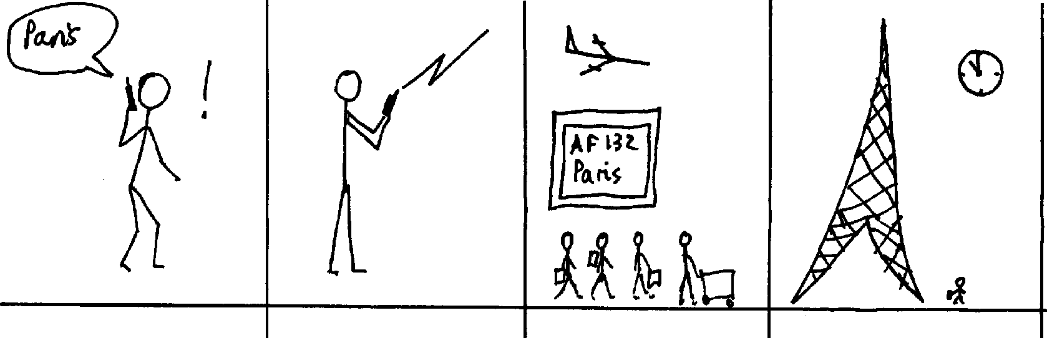
8/2/24
Representation of Scenarios (1)
Various approaches Text (informal, formal), diagrams (state, sequence ...), video, animation, comics, storyboard, collaborative workshops (pass the microphone or the ball)… There are specialized notation such as UML (sequence, activity, use case, interaction, and collaboration diagrams), Message Sequence Charts (MSC), Live Sequence Charts, and Use Case Maps (UCM)
Representation of Scenarios (2)
Different representations may be useful in specific situations – For example, storyboards, often used in the film industry, can describe situations, roles, and sequences of tasks in a fast, compact, and polyglot way¹ Some scenario-based approaches are very ideological or dogmatic [1] I. Alexander

Slide 39


8/2/24
Use Case-Driven Software Lifecycle Activities (1)
Requirements Elicitation
Requirements Analysis
System Design
Object Design
Implemen-
Testing
tation
Expressed in Terms Of
Structured By
Realized By
Implemented By
Verified By
class...
class...
class...
?
class....?
Use Case Model
Application Domain Objects
Subsystems
Solution Domain Objects
Source Code
Test Cases
Use Case-Driven Software Lifecycle
Activities (2)
Scenarios guide elicitation, analysis, design, and testing
There are many scenario-based approaches
E.g., XP employs user stories (scenarios) to directly generate tests that will guide software design and verification
Developers are often unable to speak directly to users
Scenarios provide a good enough approximation of the “voice of the user”

Slide 40
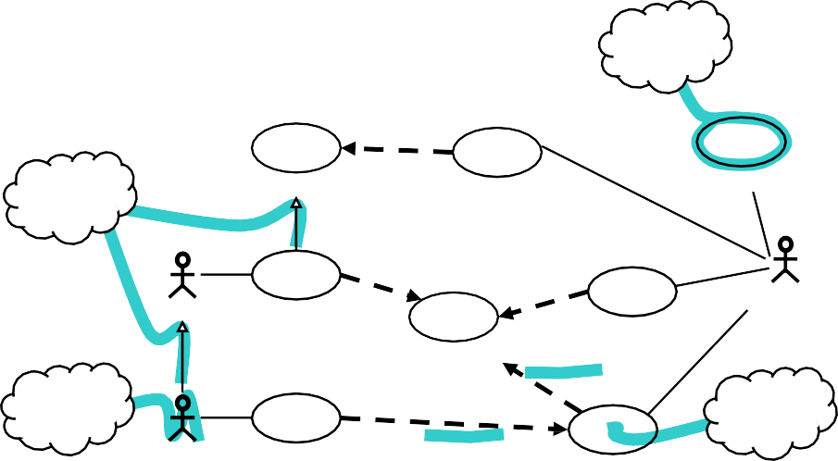
8/2/24
Use Case Modeling with UML
use case But: Where are the use cases? <<extend>> ^{Reserve Facility} Handle Waiting List ^{Register Member} generalization <<include>> ^{<<include>>} Hotel Counter Staff Customer Reserve Room Check In Customer Check Room Details <<include>> _{actor} extension <<extend>> ^{point} Member Earn and Redeem Credits Check Out Customer
Use Case Diagrams
To define system boundary (subject), actors, and use cases Subject could be: a physical system, a component, a subsystem, a class To structure and relate use cases Associate actors with use cases Include relation Extend relation Generalization (of actors and use cases)

Slide 41
8/2/24
Use Case Diagrams – <<include>>
(Inclusions)
Inclusions allow one to express commonality between several different use cases
Inclusions are included in other use cases
Even very different use cases can share a sequence of actions (reuse)
Enable you to avoid repeating details in many use cases (consistency)
An inclusion represents the execution of a lower-level task with a lower-level goal (→ decomposition of complex tasks)
Base use case references the included use case as needed
Base use case cannot exist without the included use case
When included use case is done, control returns to base use case
Disadvantage: have to look in multiple places to understand use case
Use Case Diagrams – <<extend>>
(Extensions)
Used to make optional interactions explicit or to handle exceptional cases
By creating separate use case extensions, the description of the basic use case remains simple
– Note: the base use case can still be executed without the use case extension
Extension points must be created explicitly in the base use case
Use sparingly: there is disagreement over the semantics

Slide 42
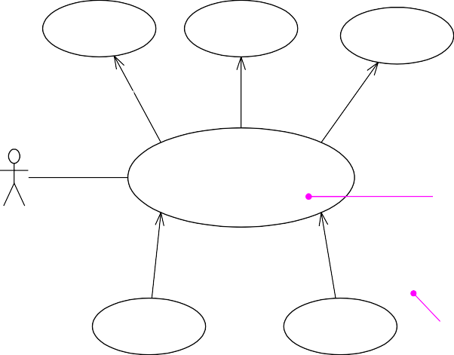
8/2/24
Use Case Diagrams – Generalizations
Much like super-classes in a class diagram Need to satisfy “is-a” relation Applies to use cases and to actors A generalized use case represents several similar use cases One or more specializations provide details of the similar use cases Inheriting use case can replace steps of inherited use case Particularly useful for actors (clearer here, unlike use case generalization where the semantics are unclear – use generalization of use cases with caution)
Example: HR System
Update Medical Plan
Update Dental Plan
Update Insurance Plan
<<include>>
<<include>>
<<include>>
Update Benefits
Extension points
benefit options:
after required enrollments
extension point name and location
Employee
<<extend>> employee requests reimbursement option
<<extend>> employee requests stock purchase option
Elect Reimbursement for Healthcare
Elect Stock Purchase
extension condition

Slide 43
8/2/24
Use Case Templates (1)
There are many different templates for use cases but they often consist of a subset of the following items: Identifier: unique label for use case used to reference it elsewhere Name: succinctly state user task independently of the structure or implementation Suggested form “verb object” (e.g., Order a product) Authors: people who discovered use case Goal: short description of expected outcome from actors’ point of view Preconditions: what needs to be satisfied before use case can begin Postconditions: state of system after completion of use case Minimal guarantee: state of system after completion regardless of outcome
Use Case Templates (2)
Primary actor: initiates the use case Participants (secondary actors): other actors involved in use case, provide services to the system and interact with the system after the use case was initiated Related requirements: identifiers of functional and non-functional requirements linked to the use case Related use cases: identifiers of related use cases Specify relationship: e.g. Supposes use case UC2 has been successfully completed Alternative to use case UC3 – ... Description of events (scenarios) Different use case description formats Narrative, Simple column, Multiple columns

Slide 44
8/2/24
Use Case Templates – Narrative Form
Paragraph focusing on the primary scenario and some secondary ones
Very useful when the stakeholders first meet
A User inserts a card in the Card reader slot. The System asks for a personal identification number (PIN). The User enters a PIN. After checking that the user identification is valid, the System asks the user to chose an operation...
Use Case Templates – Simple Column
Form
Linear sequences (main and alternatives)
A User inserts a card in the Card reader slot.
The system asks for a personal identification number (PIN).
The User enters a PIN.
The System checks that the user identification is valid.
The System asks the user to chose an operation
The Card is not valid.
The System ejects the Card.
The User identification is not valid.
The System ejects the Card.

Slide 45
8/2/24
Use Case Templates – Multiple Column
Form
One column per actor
Allows for a more detailed view
User's actions System responses
Insert a card in the Card reader 2. Ask for a personal slot. identification number (PIN).
(card is not valid see alternative 1.1)
3. Enter a PIN.
4. Check that the user identification is valid. (identification is not valid see alternative 4.1)
5. Ask User to chose an operation
Use Case Templates – Example Template
A. Name: Give a short, descriptive name to the use case
B. Actors: List the actors who can perform this use case
C. Goals: Explain what the actors are trying to achieve
D. Preconditions: State of the system before the use case
E. Description: Give a short informal description
F. Trigger: Describe the event that initiates the activity
G. Summary: Summarize what occurs as the actors perform the use case
F. Related use cases: (in accordance with use case diagram)
G. Steps: Describe each step using some form (single/multiple columns)
H. Postconditions: State of the system following completion
I. Special Requirements: Non-functional requirements and constraints

Slide 46
8/2/24
Use Case Development – Example: ATM
System (1)
Determine candidate system scope and boundaries
Identify stakeholders
Identify problem - Create problem statement
Use interviews and other techniques
ATMs +
Bank
ATMs
ATM
Software
1
- Customer
2
- Customer
- Bank
3
- Card reader
Cash dispenser
- Key pad
Touch screen
Printer
Bank
Use Case Development – Example: ATM
System (2)
Identify actors
Who interacts with the system?
Who or what uses the system?
For what goals?
What roles do they play?
Who installs the system?
Who or what starts and shuts down the system?
Who maintains the system?
Who or what gets and provides information to the system?
Does anything happen at a fixed time?
Check for possible actor generalization
Example ATM with scope 2
Bank Customer
Installation Technician Administrator
Administrator
Bank
Weekly Reports

Slide 47
8/2/24
Use Case Development – Example: ATM
System (3)
Identify actors (cont’d)
Choose actors’ names carefully
Actors give value, get value from system or both
Should reflect roles rather than actual people
An actor specifies a role an external entity adopts when it interacts directly with your system
People / things may play multiple roles simultaneously or over time
Use right level of abstraction
Poor act or nam e | Good act or nam e
Clerk | Pension Clerk
Third-level supervisor | Sale supervisor
Data Entry Clerk #165 | Product accountant
Eddie “The Dawg” Taylor | Customer service representative
Use Case Development – Example: ATM
System (4)
Example actor: Customer
3. Identify use cases
Goal: Access account 24/7 for
Identify and refine actors’ goals
Why would actor AAA use the system?
Identify actors’ tasks to meet goals
What interactions would meet goal GGG of actor AAA?
Chose appropriate use case names
Verb-noun construction
No situation-specific data
regular banking operations (withdrawal, deposit, statement...) in a timely and secure way.
To be refined into sub-goals.
From goals we can identify tasks: Withdraw Cash, Make Deposit, Print Account Statement....
Not tied to organization structure, paper forms, computer implementation, or manual process (e.g., enter form 104-B, complete approval window, get approval from immediate supervisor in Accounting Department)

Slide 48
8/2/24
Use Case Development – Example: ATM
System (5)
Identify use cases (cont’d)
Develop a brief description in narrative form
e.g., description of use case Withdraw Cash
The Customer identifies herself to the system, then selects the cash withdrawal operation. The system asks for the amount to withdraw. The Customer specifies the amount. The system provides the requested amount. The Customer takes the amount and leaves.
Identify preconditions
e.g., preconditions of use case Withdraw Cash
System is in operation, cash is available
Use Case Development – Example: ATM
System (6)
Definition of primary scenario
Happy day story where everything goes fine
Definition of secondary scenarios (alternatives/exceptions)
A method for finding secondary scenarios is to go through the primary scenarios and ask:
Is there some other action that can be taken at this point? (alternate scenario)
Is there something that could go wrong at this point? (exception scenario)
Is there some behavior that could happen at any time? (alternative scenario unless it is an error, then it would be an exception scenario)
Example use case: Withdraw Cash
Not enough cash available
Incorrect identification
Customer forgets card in card reader
Incorrect amount entered
Customer forgets cash in dispenser

Slide 49


8/2/24
Use Case Development – Example: ATM
System (7)
Structure use case diagram
Identify commonalities and specify included use cases
Identify variants and specify extended use cases
Withdraw Cash
Identify Customer
Bank
<<include>>
<<include>> <<include>>
Customer
Make Deposit
Print Account Statement
Use Cases Development (1)
Heuristics for finding use cases Select a narrow vertical slice of the system (i.e., one scenario) Discuss it in detail with the user to understand the user’s preferred style of interaction Could target high value or high risk first Select a horizontal slice (i.e., many scenarios) to define the scope of the system Discuss the scope with the user Use illustrative prototypes (e.g., mock-ups) as visual support Find out what the user does Task observation (preferable to questionnaires)

Slide 50
8/2/24
Use Cases Development (2)
Alternative ways of identifying use cases (Ham, Larman) Identify external events to which the system must respond, and then relate these events to participating actors and specific use cases Express business processes in terms of specific scenarios, generalize the scenarios into use cases, and identify the actors involved in each use case Derive likely use cases from existing functional requirements – if some requirements do not trace to any use case, consider whether you really need them
Use Cases Development (3)
Often one use case (or a very small number) can be identified as central to the system The entire system can be built around this particular use case There are other reasons for focusing on particular use cases: Some use cases will represent a high risk because for some reason their implementation is problematic Some use cases will have high political or commercial value Approach is iterative System scope and boundaries may change as more information is known about actors, their goals, and use cases

Slide 51
8/2/24
Example: University Registration System | (1)
Enroll in <<include>> _{Enroll in} ^{Registrar} University _{Course} <<extend>> Applicant _{Perform} Enroll Family _{Security Check} Member of Staff International Applicant RCMP Security System
Example: University Registration System | (2)
Name: Enroll in University Identifier: UC 19 Goal: Enroll applicant in the university Preconditions: The Registrar is logged into the system. The Applicant has already undergone initial checks to verify that they are eligible to enroll. Postconditions: The Applicant will be enrolled in the university as a student if they are eligible.

Slide 52
8/2/24
Example: University Registration System | (3)
Main Flow: An applicant wants to enroll in the university. The applicant hands a filled out copy of form UI13 University Application Form to the registrar. The registrar visually inspects the forms. The registrar determines that the forms have been filled out properly. The registrar selects to Create New Student. The system displays the Create Student Screen. The registrar inputs the name, address, and phone number of the applicant. [Extension Point: XPCheck] The system determines that the applicant does not already exist within the system. The system determines that the applicant is on the eligible applicants list. The system adds the applicant to its records. The registrar enrolls the student in courses via use case UC 17 Enroll in Course. The system prepares a bill for the applicant enrollment fees. Alternate Flows: 4.a The forms have not been adequately filled…
Example: University Registration System | (4)
Name: Perform Security Check Identifier: UC 34 At Extension Point XPCheck: The registrar asks for security check results about applicant. The system asks RCMP Security System for applicant security check results. The RCMP Security System responds that applicant has been cleared. 3.a The Security System responds that applicant has not been cleared

Slide 53
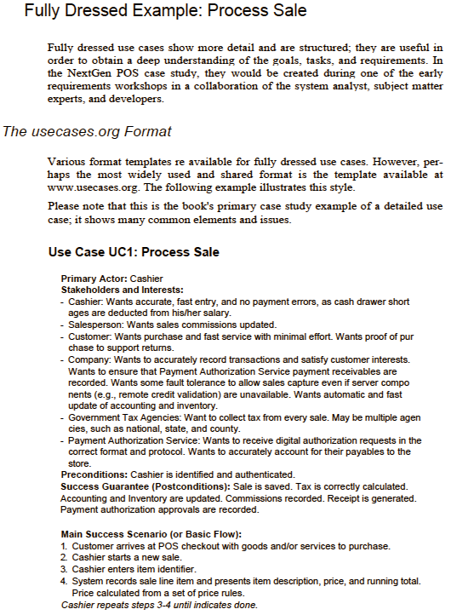
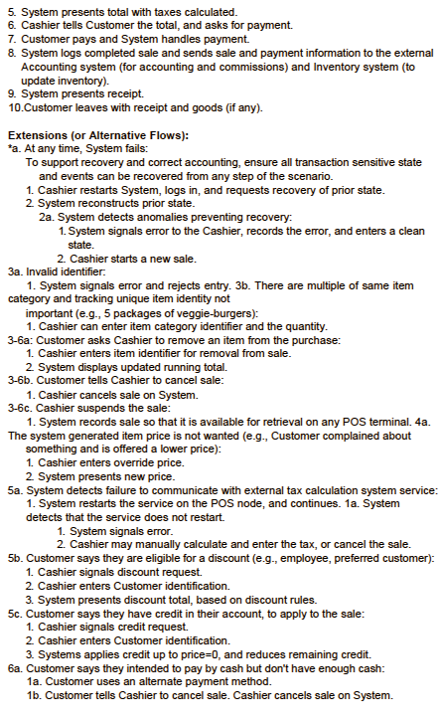
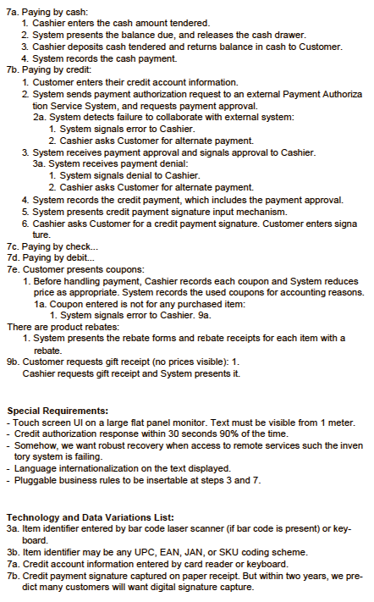
8/2/24
Example: University Registration System | (5)
Name: Enroll Family Member of Staff Identifier: UC 20 Inherits From: UC 19 Main Flow: An applicant family member wants to enroll in the university. The applicant hands a filled out copy of form UI15 University Application Form for Family Members to the registrar. … 12. The system prepares a bill for the applicant enrollment fees based on staff family members rate. Alternate Flows: …
Example: Point of Sale Application
Source: Craig Larman “Applying UML and Patterns”

Slide 54
8/2/24
Use Case Development – Rules of Thumb (1)
Be careful not to over specify behavior
Keep it short, keep it simple: main flow should fit on a single page
Focus on what, not how:
Focus on externally visible behavior
Are you specifying a sequence of events, in which the sequence does not really matter?
Example: Order of entering data for new customer
Do you specify which elements from a set are selected, when any arbitrary element is needed?
Example: Selecting new arbitrary phone number
Use Case Development – Rules of Thumb (2)
Be careful not to under specify behavior
Do not forget variations on basic flow
Do not forget exceptions
For example, what happens to a phone call if there are no resources to allocate to it?
Specify behavior for all possible inputs, both valid and invalid input

Slide 55
8/2/24
Use Case Development – Rules of Thumb (3)
Keep names, data at an abstract level suitable for users
For example, input and output events should have intuitive names
Avoid data definition in use cases
Use cases need to be understandable by users
They must validate them
Avoid functional decomposition
Do not try to structure the use cases as nested functions with
«includes»
Avoid deep hierarchies with «includes»
Use Case Development – Rules of Thumb (4)
Think of use cases before use case diagram
Do not spend too much time on the use case diagram – the textual description is the most important part
Avoid too much use of "extends" and "includes" in use case diagrams
Do not describe the user interface
You do not want too many use cases; if you have too many, you have probably included too much detail (“If in doubt, leave it out”)
Do not attempt to describe everything – too many variations – too many things that can go wrong
The requirements specification captures a more complete picture

Slide 56
8/2/24
Benefits of Use Case-Based Software
Development
They can help to define the scope of the system
They are often used to plan the development process
They are used to both develop and validate the requirements
Simple, easy to create
All stakeholders understand them
Often reflect user's essential requirements
Separates normal behavior from exceptional behavior
They can form the basis for the definition of test cases
They can be used to structure user manuals
Use Cases are Not a Panacea…
The use cases themselves must be validated Using the requirements validation methods Question/observe many types of users There are some aspects of software that are not covered by use case analysis How to integrate nun-functional requirements? Innovative solutions may not be considered Scalability and maintainability Others discussed by Stephen Ferg in “What's Wrong with Use Cases”

Slide 57
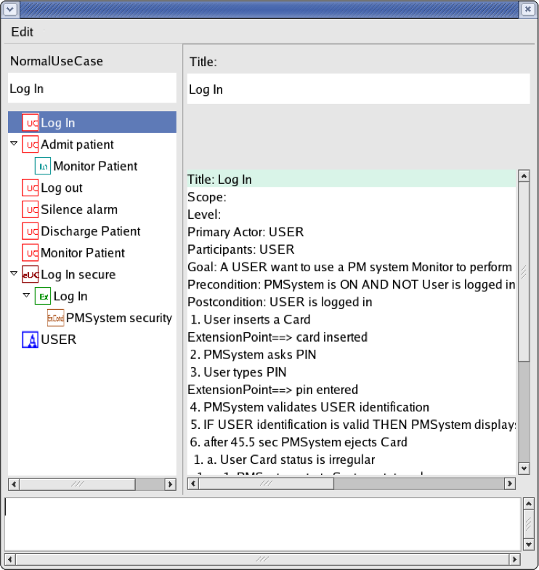
8/2/24
Tools
Many UML tools support use case diagrams, without really supporting use cases well UCEd tool (Prof. Somé), to help capture/validate use cases Use Case edition (structured English) Domain model edition (and automatic extraction) Scenario edition Use Case & Domain model validation Use Cases combination in state models Simulation of executable model derived from Use Cases Scenario generation http://www.site.uottawa.ca/~ssome/Use_Case_Editor_UCEd.htm l
Use Case Edition with UCEd
Use Case model edition _{Use Case} area description edition area Use Case model (use case, extend, include, actor…) Use Case description

Slide 58
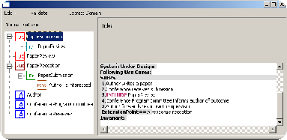
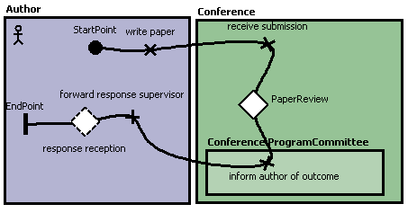

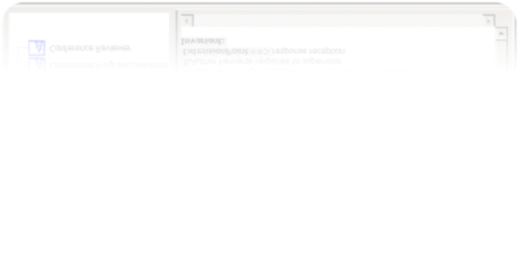
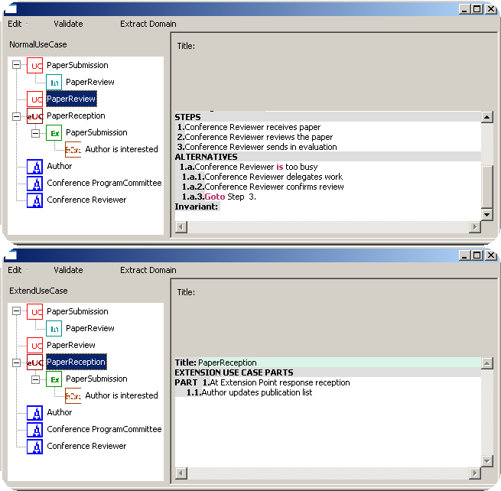
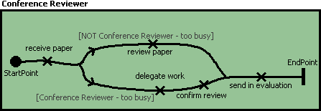

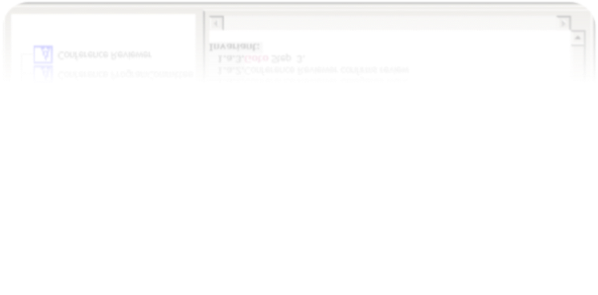
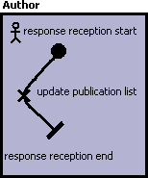



8/2/24
UCEd Model Import in jUCMNav
Don’t be Negative, But…
Be ready to face the music! In business, some people might wish to see you fail… There are unforeseen events in any project Open systems are subject to various threats Software contains various kinds of bugs Remember Murphy’s Law… “Anything that can go wrong will go wrong.”

Slide 59
8/2/24
Think about Negative Scenarios?
A negative scenario is a scenario whose goal is Undesirable from the business organization’s viewpoint Desirable from a hostile agent’s viewpoint (not necessarily human) Consider them beforehand As well as potential solutions Or… Wait until it is too late to react…
Misuse Case | Thief
threatens Drive Car _{Steal Car} Proposed by Sindre et Opdahl (2000) Capture use cases that a system must be protected against Goal is to threaten the system Obvious applications for security and risk analysis The misuse case’s misactor is a hostile agent The colors of the ellipse are inverted

Slide 60
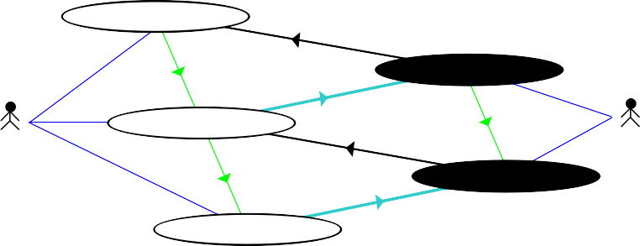
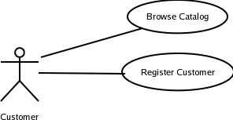
8/2/24
 | A MiniMax¹ for Security Drive the Car threatens ^{includes} Steal the Car mitigates Lock the Car ^{includes} Driver threatens ^{Car Thief} ^{includes} Short the Ignition mitigates Lock the Transmission Use Cases for 'Car Security' Similar to a chess match… White’s best move is to find Black’s best move and to counter it New relations: threatens (from misuse case to use case) mitigates (from use case to misuse case) Minimax: minimizing the maximum possible loss
• •
Driver
Car Thi
Driver
Finding Misuse Cases – Step 1
Start from a normal use case diagram Find misactors (hostile roles) Who are the misactors, who want: To harm the system, its stakeholders, or their resources intentionally or To achieve goals that are incompatible with the system's goals Competitor Crook …

Slide 61
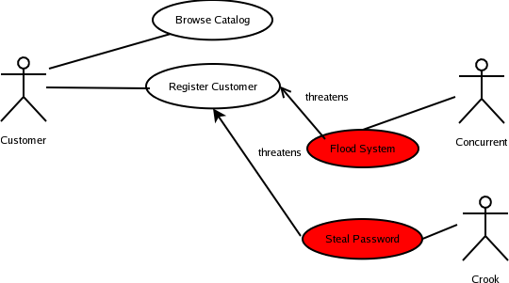
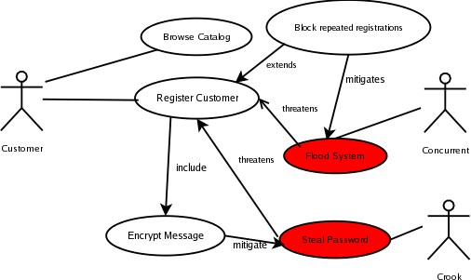
8/2/24
Finding Misuse Cases – Step 2
Find misuse cases Ask what would a misactor do to harm system Express goals of misactors (if needed elaborate with scenarios) Add relationships (threaten) Competitor
Finding Misuse Cases – Step 3
Mitigate misuse cases Ask what would neutralize the threats New included use case, new extension use case, or new secondary scenario to existing use case might be added Competitor

Slide 62
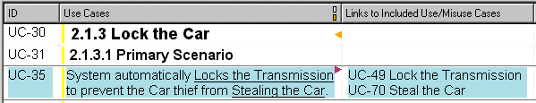
8/2/24
Benefits and Risks of Misuse Cases
Benefits Elicitation of security and safety requirements Early identification of threats, mitigations, and exceptions that could cause system failure Early identification of test cases Documentation of rationales Risks Get into premature design solutions in step 3 (mitigation) Goal should be to find requirements (safety, security…) Missing misactors and threats in a partial view
Tool: DOORS Plug-in
Scenario Plus (for Telelogic DOORS)
Textual / Graphical output (HTML)
Automatic links, metrics, etc.
Upon referencing: automatic creation of use/misuse cases
Automatic creation of links between misuse and use cases, by searching for underlined use case names with simple fuzzy matching

Slide 63


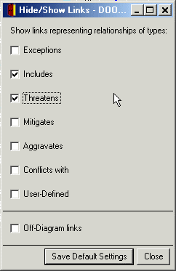
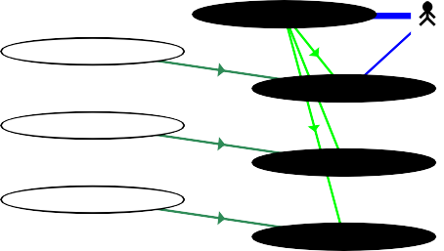
8/2/24
Conflict and Trade-off Analysis
Sabotage
threatens
Rogue Employee
Access the Services
^{threatens} aggravates
Service User
includes
threatens _{mitigates}
Frustrated by Controls
Service User
CinocnlutrdoelsLoosely
^{threatens} aggravates
Security Officer
conflicts with
aggravates
Denial-of-Service Attack
Control Strictly
includes
mitigates
Intrude into System
includeLs og Access Attempts
mitigates
includes
Hacker
includes
Brute-FoirncceluPdaessword Attack
Operate Firewall
includes
mitigates
Attack Unblocked Ports
Recognize Users
mitigates
Impersonate Users
Use Cases for 'Web Portal Security'

